Slide 1
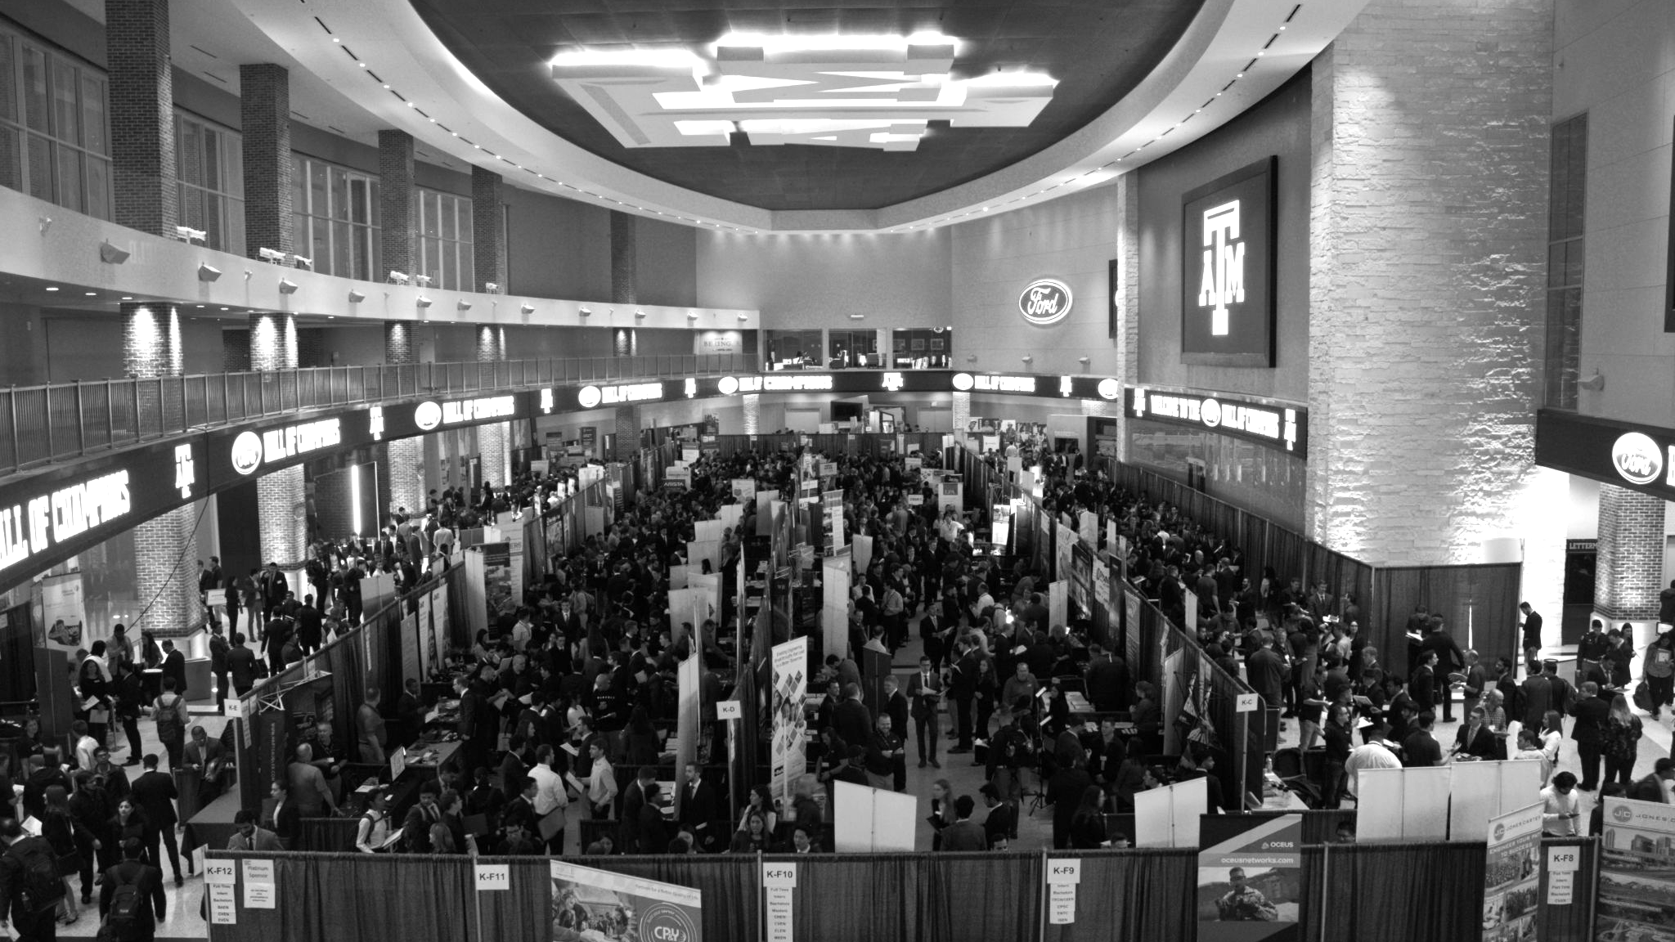

LANL Team Update
9/3/2024
Izzy Baumler, Dalton Boeckmann, Morgan Gullo, Jade Waldron

Slide 2
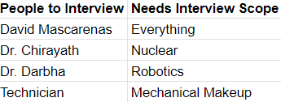
Weekly Task Updates
Continuing Research for DR1 Report
After talking with Dr.Tsenn we have divided up the DR1 research topics
Jade - Arm attachments and storage
Morgan - Arm attachments and storage
Dalton - Dynamic behavior of control arm
Izzy - Electrical behavior of control arm
Meeting with Shuangyu Xie delayed to next tuesday to discuss arm attachment for her weed removal project
Creating our list of people we want to interview

Slide 3
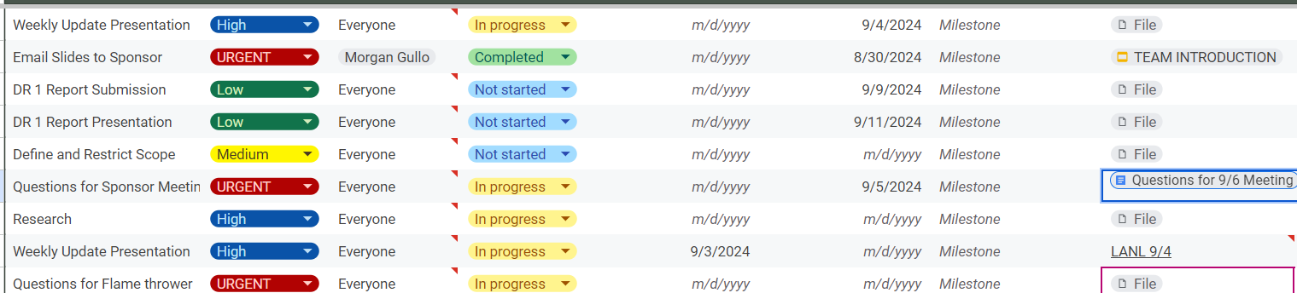
Weekly Task Updates

Slide 4
Upcoming Week
Meeting with our sponsor on 9/6 at 1 PM
We have prepared questions for him to hopefully answer
Conducting Interviews for Needs Analysis
Finalizing and Submitting our DR1 Reports
Meeting with Shuangyu Xie 9/10

